Slide 1
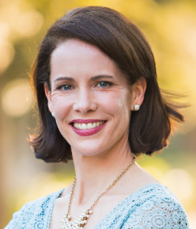
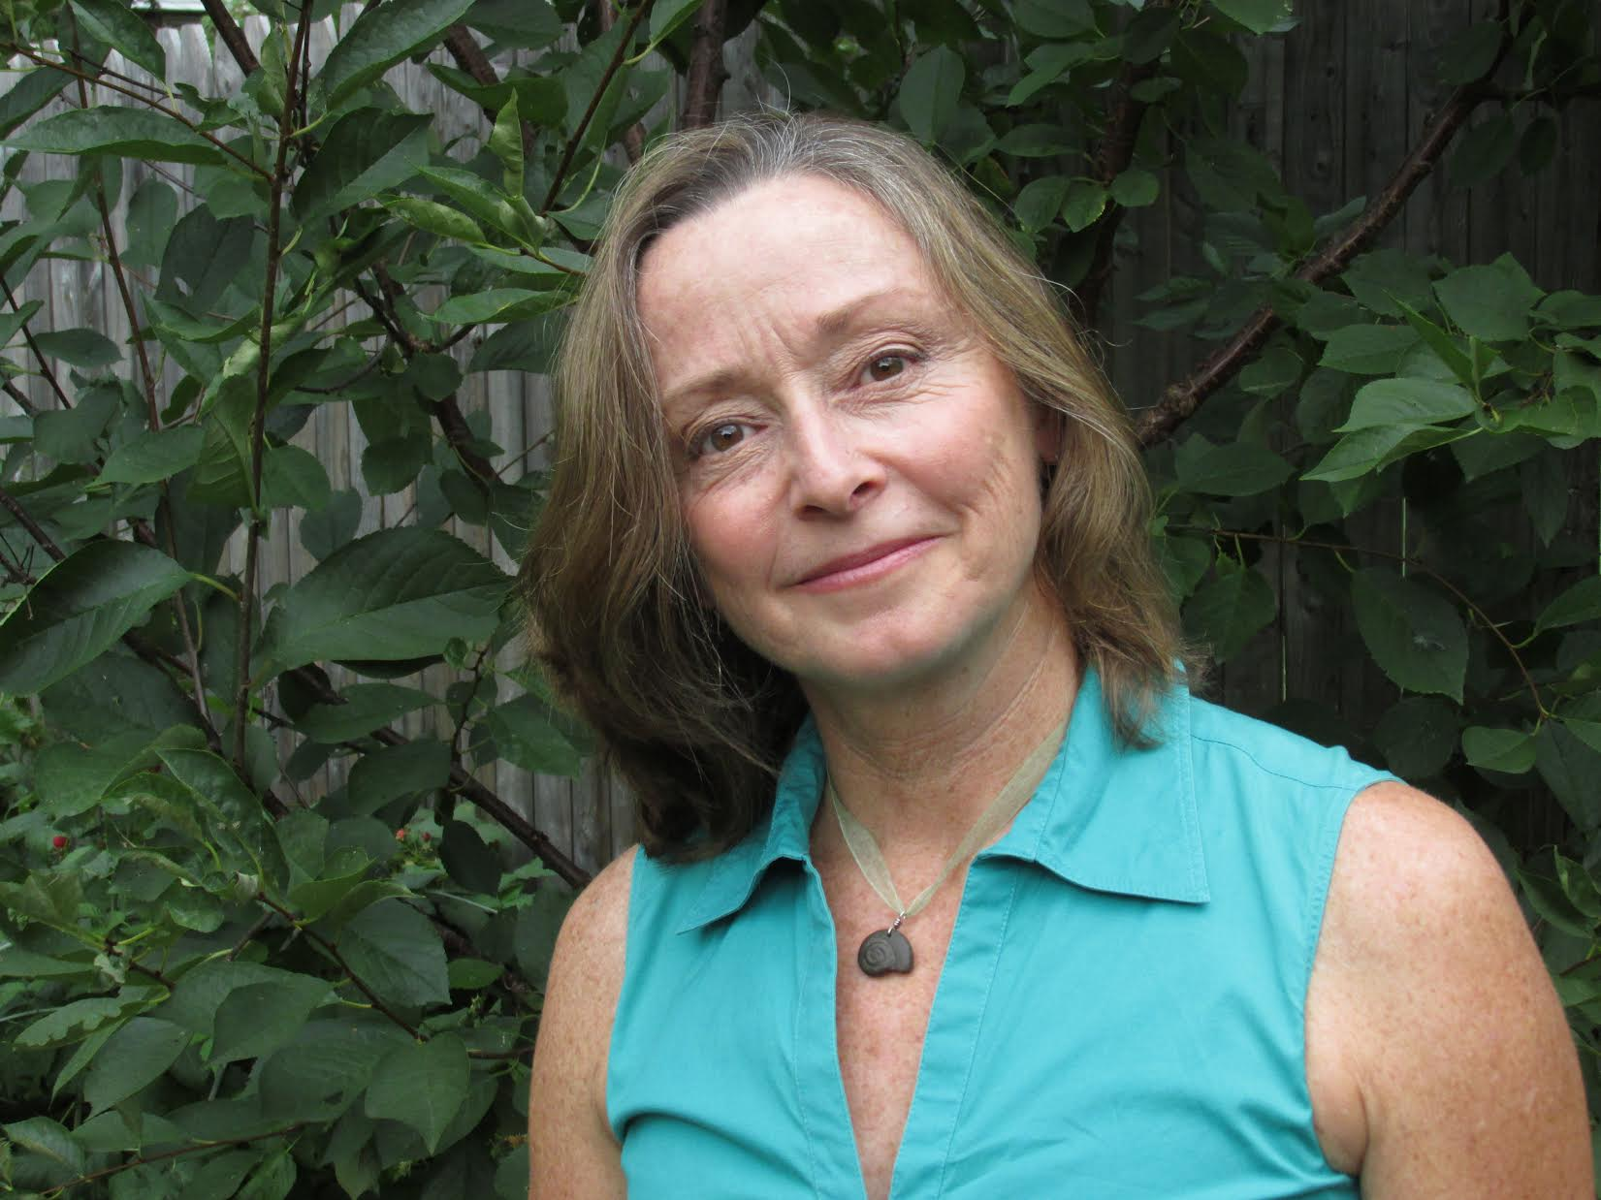
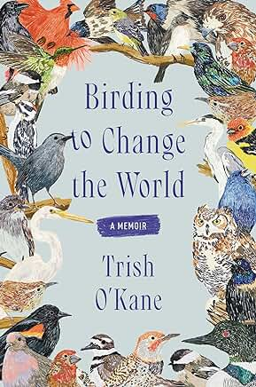
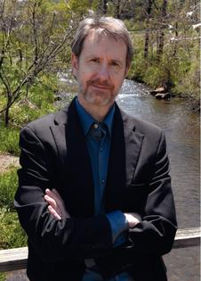
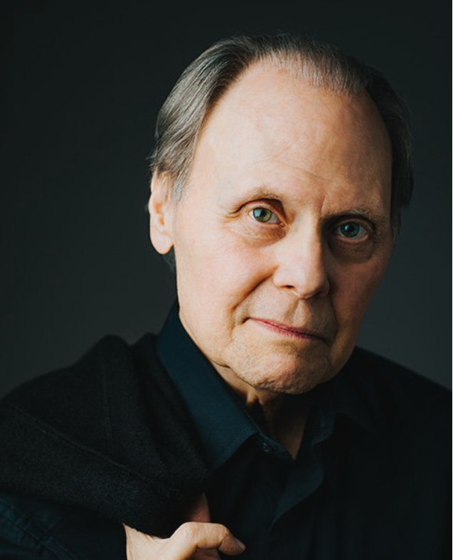
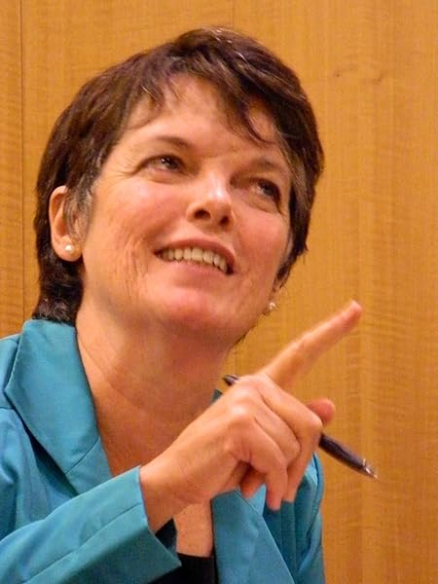
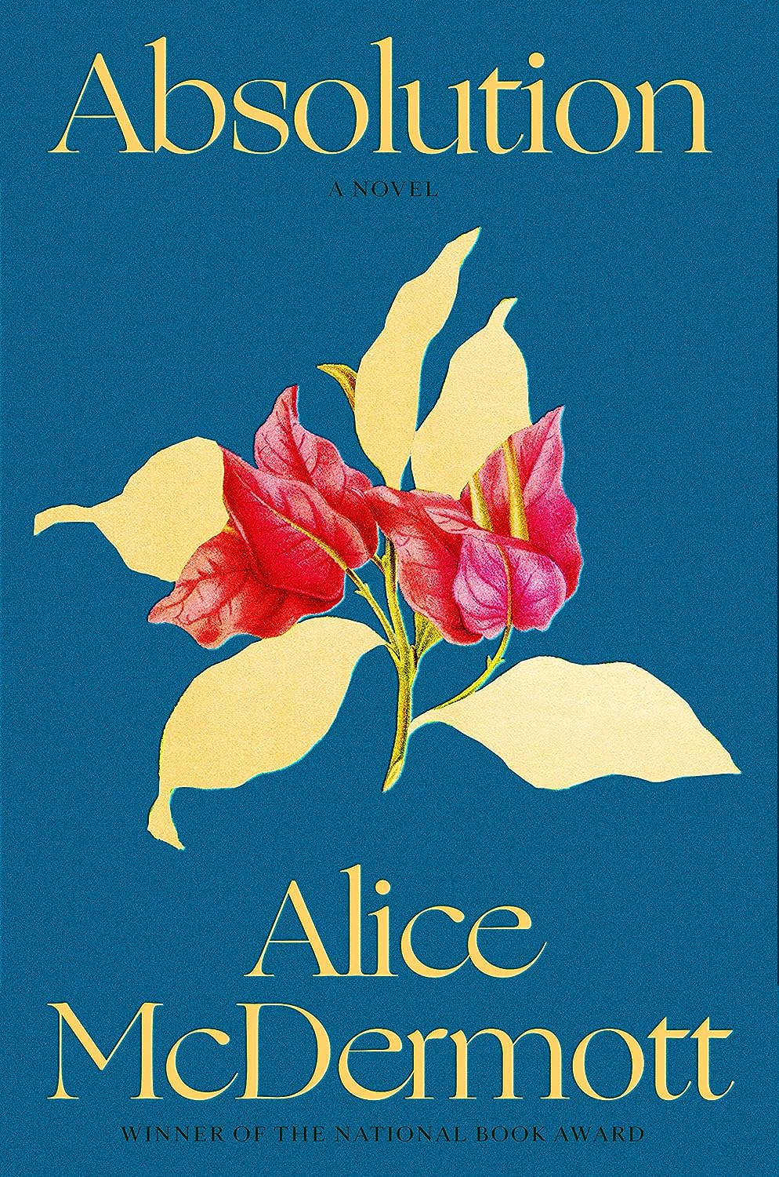
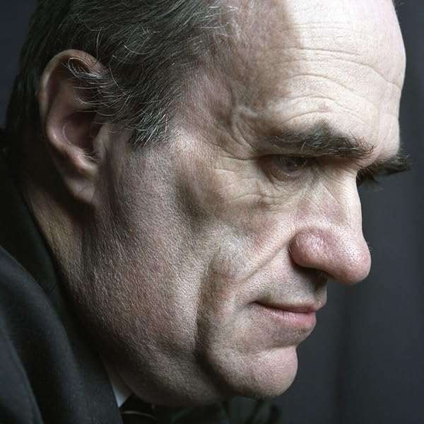
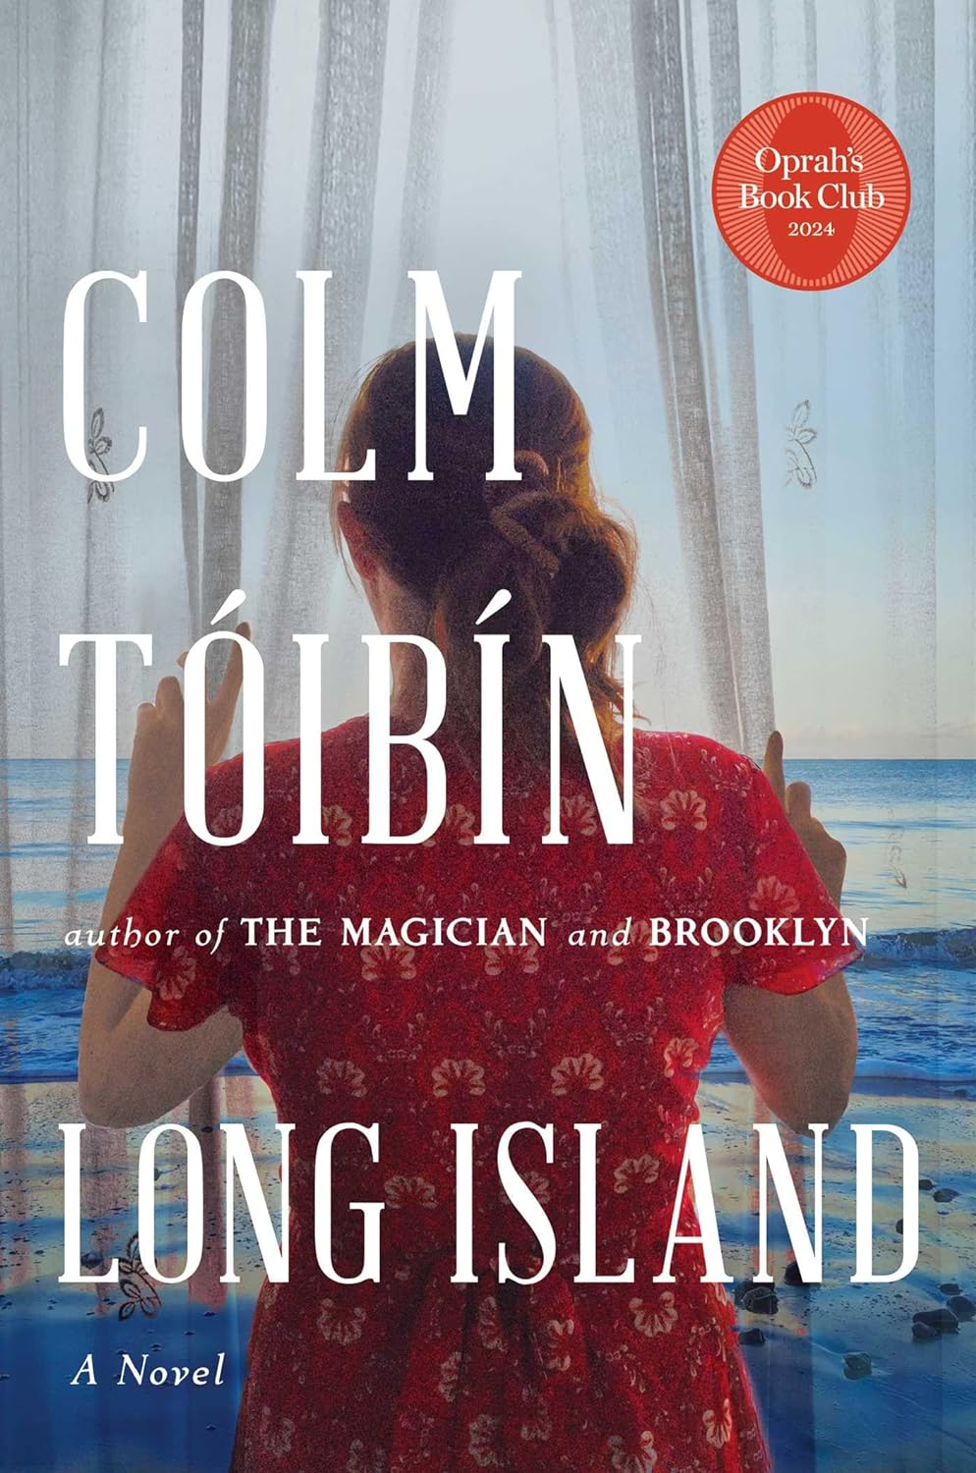
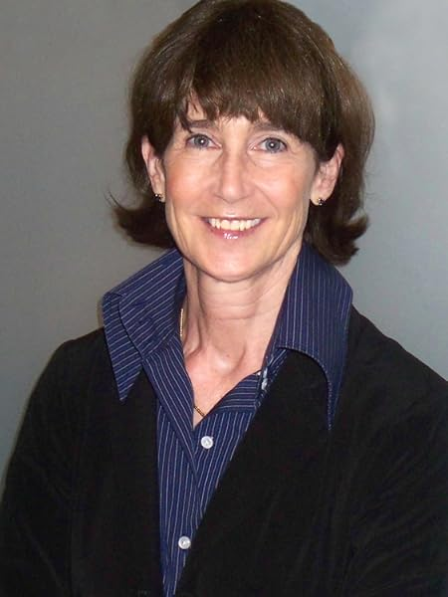
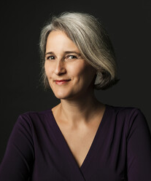
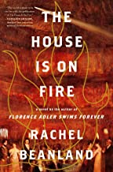
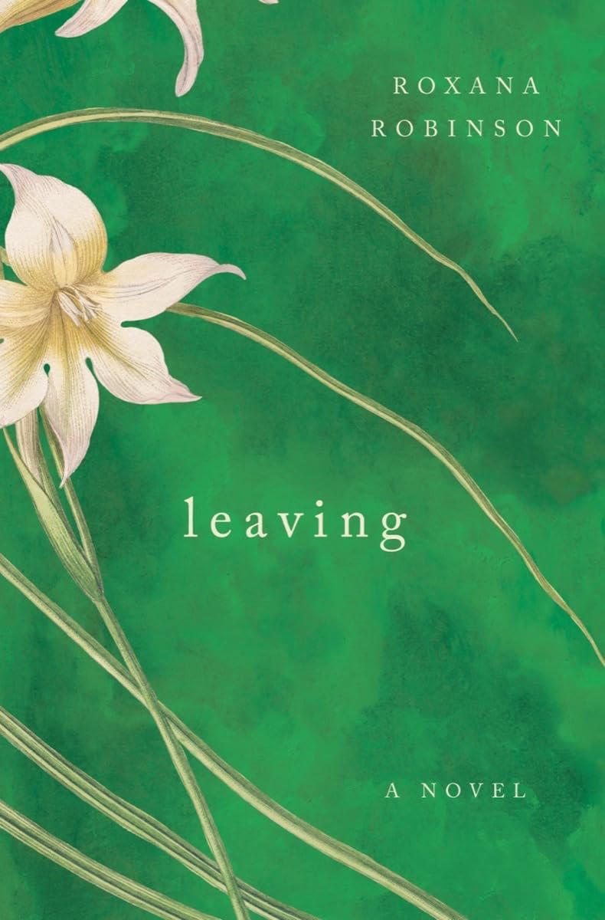
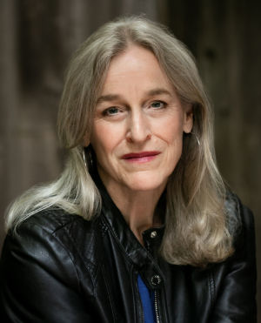
2024-2025 Schedule of Authors
For questions and membership information, contact
Ricki Michals 772-559-3178 or rickimichals@gmail.com
Tuesday, November 12, 2024 - Featuring Trish O’Kane
Birding to Change the World is a memoir following an investigative journalist who becomes an obsessive ornithologist. We are treated to the astonishing science of bird life, from migration and parenting to territorial defense strategies that influence the author’s own activism when her beloved park is threatened. It is a guide to loving birds and people and to their mutual dependence upon one another.
Tuesday, December 10, 2024 - Featuring Ron Rash
The Caretaker, chosen as one of The New Yorker’s Best Books of the Year, is a story set in a small Appalachian town during the Korean War. It is a tender examination of male friendship and rivalry, as well as a compelling, page-turning novel of family devotion. The starring characters depict the human capacity for delusion and destruction all too often justified as acts of love.
Tuesday, January 21, 2025 - Featuring Alice McDermott
Winner of many accolades, Absolution is the riveting story of women’s lives on the margins of the Vietnam War. It is the story of Saigon in 1963 and revisited sixty years later. Discover two women’s existences on the periphery – of politics, history, war and their husbands’ convictions – as they’ve been shaped and burdened by the unintended consequences of America’s sojourn in Southeast Asia.
Tuesday, February 18, 2025 - Featuring Colm Toibin
Generously funded in memory of IRLS member Heidi Truscott, Oprah Book Club pick Long Island is the sequel to Brooklyn, featuring Irish heroine Ellis Lacey. It is the story of a woman alone in a marriage and the deepest bonds she rekindles on her return to the place and people she left behind. The novel is suspenseful, about secrets and dreams and the conflict of desire over duty. It is dazzling while devastating.
Tuesday, March 18, 2025- Featuring Roxana Robinson
College sweethearts Sarah and Warren meet again, by chance, years later. Leaving is an engrossing exploration of the vows we make to one another, the relationship of parents and their children, and what we owe to others and to ourselves. This is a portrayal of desire and loyalty, as our subjects confront the moral and conflicting responsibilities of their love for their families and for each other.
Tuesday, April 15, 2025- Featuring Patrick Bringley
All the beauty in the World: The Metropolitan Museum of Art and Me is a fascinating portrait of the Met and its treasures, written by a former New Yorker staffer who spent a decade as a museum guard. It is a memoir, but more a portrait of a great museum and the people who make it tick. And it is the saga of the resurgence of a man who originally sought solace in the museum’s dark halls but gradually, gratefully returns to his world at large.

