Slide 1

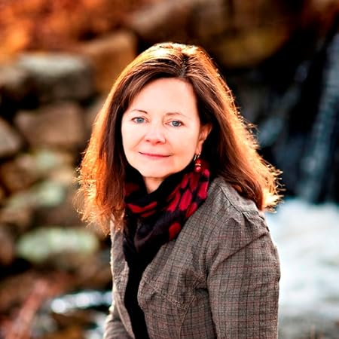

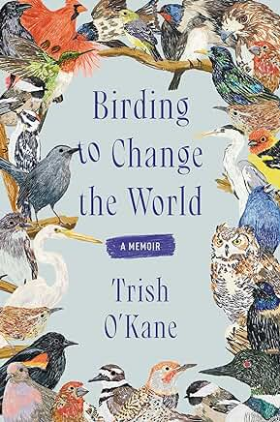

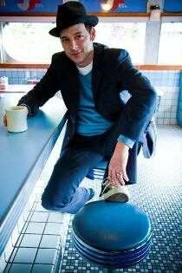
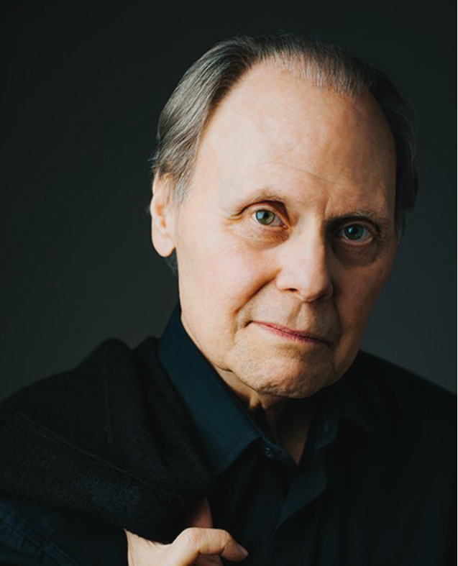


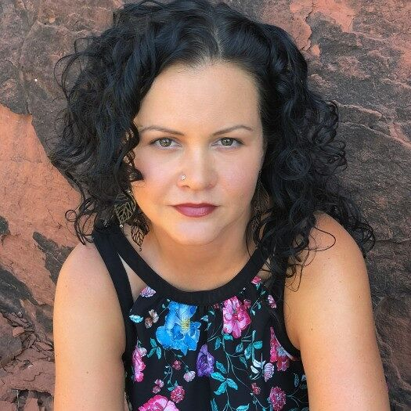





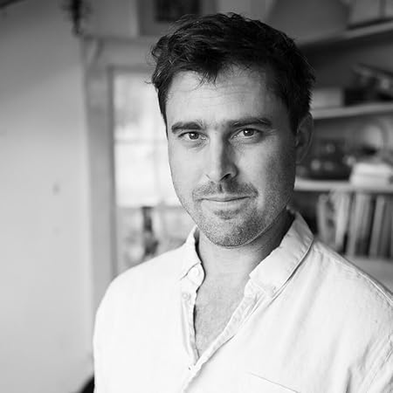
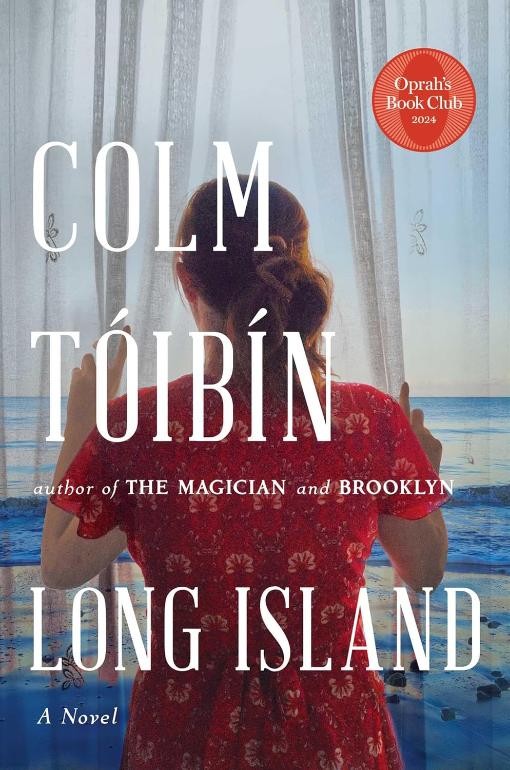


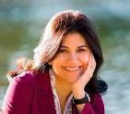
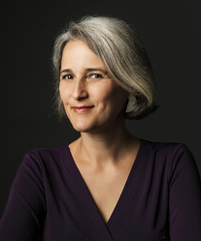

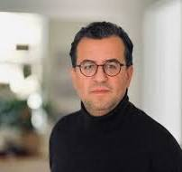



2025-2026 Schedule of Authors
For questions and membership information, contact
Dee Reiser 860-716-1111 or DCReiser@aol.com
Tuesday, November 11, 2025 - Featuring Geraldine Brooks
The surprise death of Geraldine Brooks’ adored partner of more than 30 years inspired the beloved author of Horse to retreat to a remote island off Australia. She needed to get away from the red tape and to-do lists expected of her and to finally allow herself to take the time to grieve. Memorial Days is a memoir of sudden loss, the cultural coping mechanisms that helped Brooks recover, a lesson in how to go on and perhaps an aid to us all.
Tuesday, December 2, 2025 - Featuring Jonathan Evison
The Heart of Winter is about a married couple in their golden years. The unlikely blind date that becomes 70 years of marriage delves into the euphoric ups, the deep downs, elder-complications and fights for independence that is a marriage. As Ruth struggles with illness, Abe copes with her care despite their childrens’ doubts of his ability to do so. Set on Bainbridge Island, WA, this is about true love in a very long commitment.
Tuesday, January 13, 2026 - Featuring Jeanine Cummins
Spanning 1960-2023, Speak to Me of Home is the story of a multigenerational family and their return to their roots in Puerto Rico. Cummins, the author of the widely renowned American Dirt, examines marriage, family, identity and the convoluted relationship of mothers and daughters. How can the same genetics breed such wildly different ideas of where they came from? Where, indeed, is really home?
Tuesday, February 10, 2026 - Featuring Ben Shattuck
A collection of 12 short stories set over three centuries, The History of Sound tells interconnected tales of New England characters linked over generations. Each story has a companion story which reveals something about the previous paired story. The diverse characters’ misunderstandings of the past, their mysteries, murders, desires and lingering loves add up to a collaboration soon to be a major motion picture.
Tuesday, March 10, 2026 - Featuring Marjan Kamali
A compelling story of friendship spanning 1950-2022, The Lion Women of Tehran is also an immersion into Iranian culture, history and the fight for women’s rights. This is the story of two little girls from very different backgrounds who bond over the same dream and of the life and circumstances thrown at them. As the political turmoil builds in Iran, one horrific betrayal will have enormous consequences.
Tuesday, April 14 - Featuring Hisham Mitar
Winner of many national and international recognitions, My Friends is the story of Libyan Kahled and his political awakening in Great Britain. It explores a deep relationship during the Arab Spring with an author who had inspired Kahled as a young boy. He is forced to confront life-altering tensions between revolution and safety, family and exile. My Friends is above all the the story of the sustaining power of friendship.

